Slide 1








English YEAR 6
Unit 3 – Adventure Time

Slide 2






GREETINGS, STUDENTS!

Slide 3





LEARNING OBJECTIVES
By the end of the lesson, pupils will be able:
Give detailed information about themselves and others.
Understand specific information and details of simple longer texts.
Understand more complex supported questions.

Slide 4
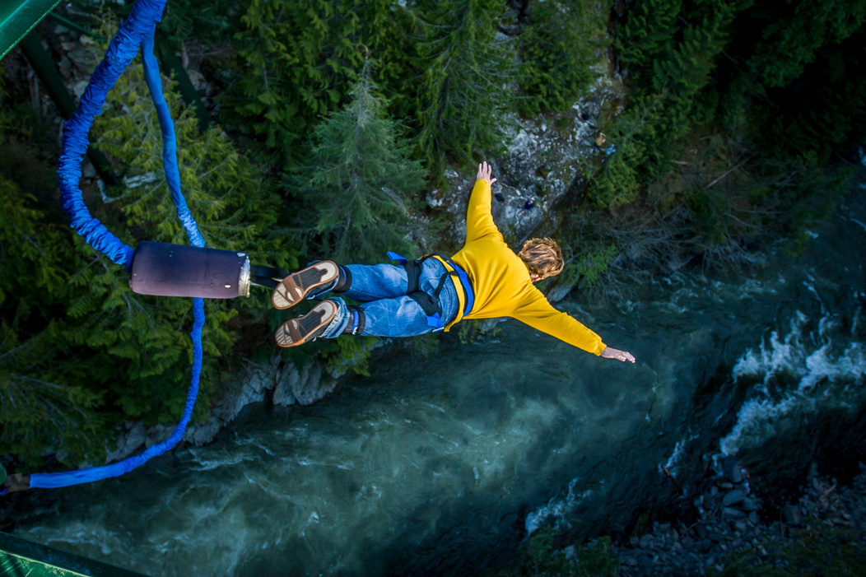
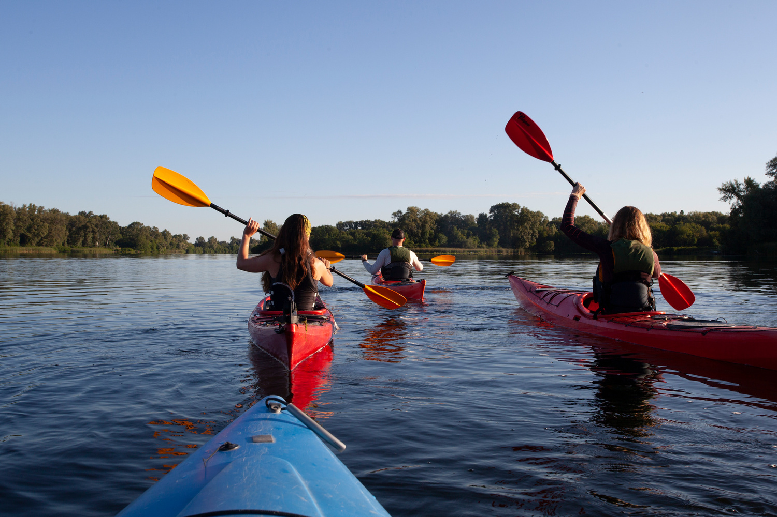
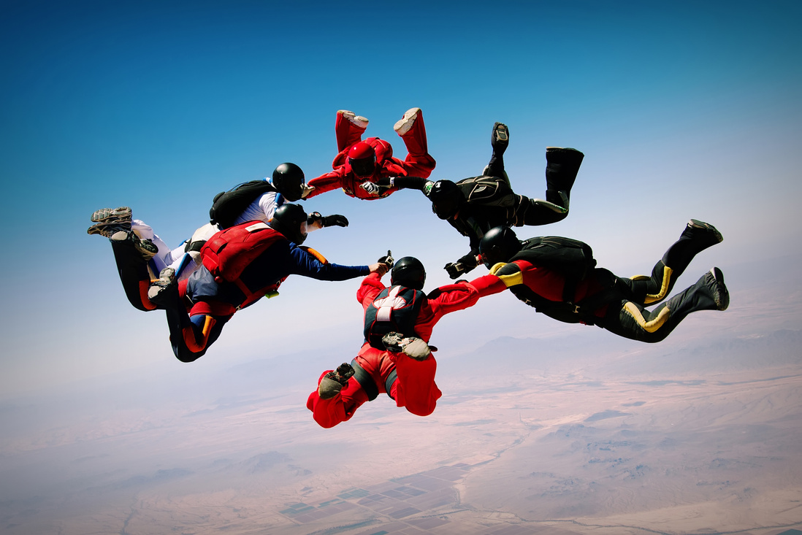


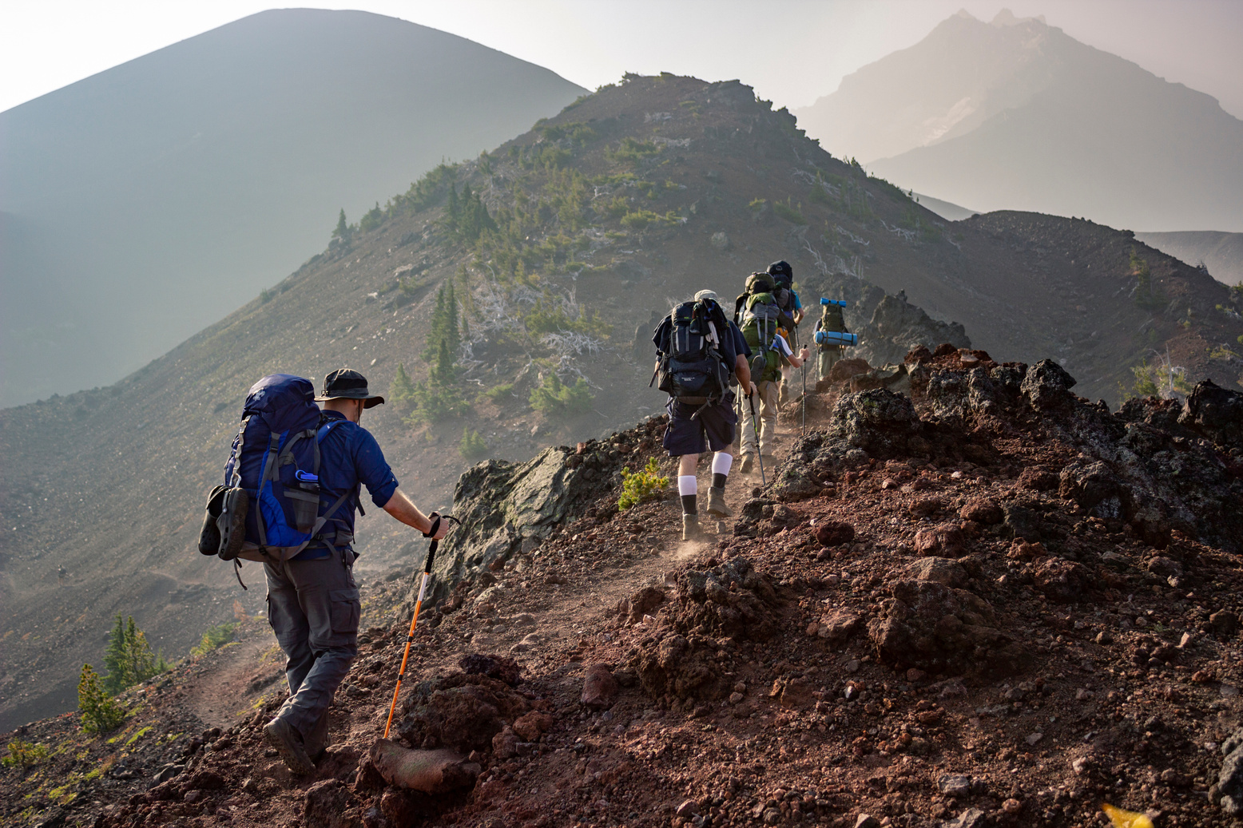
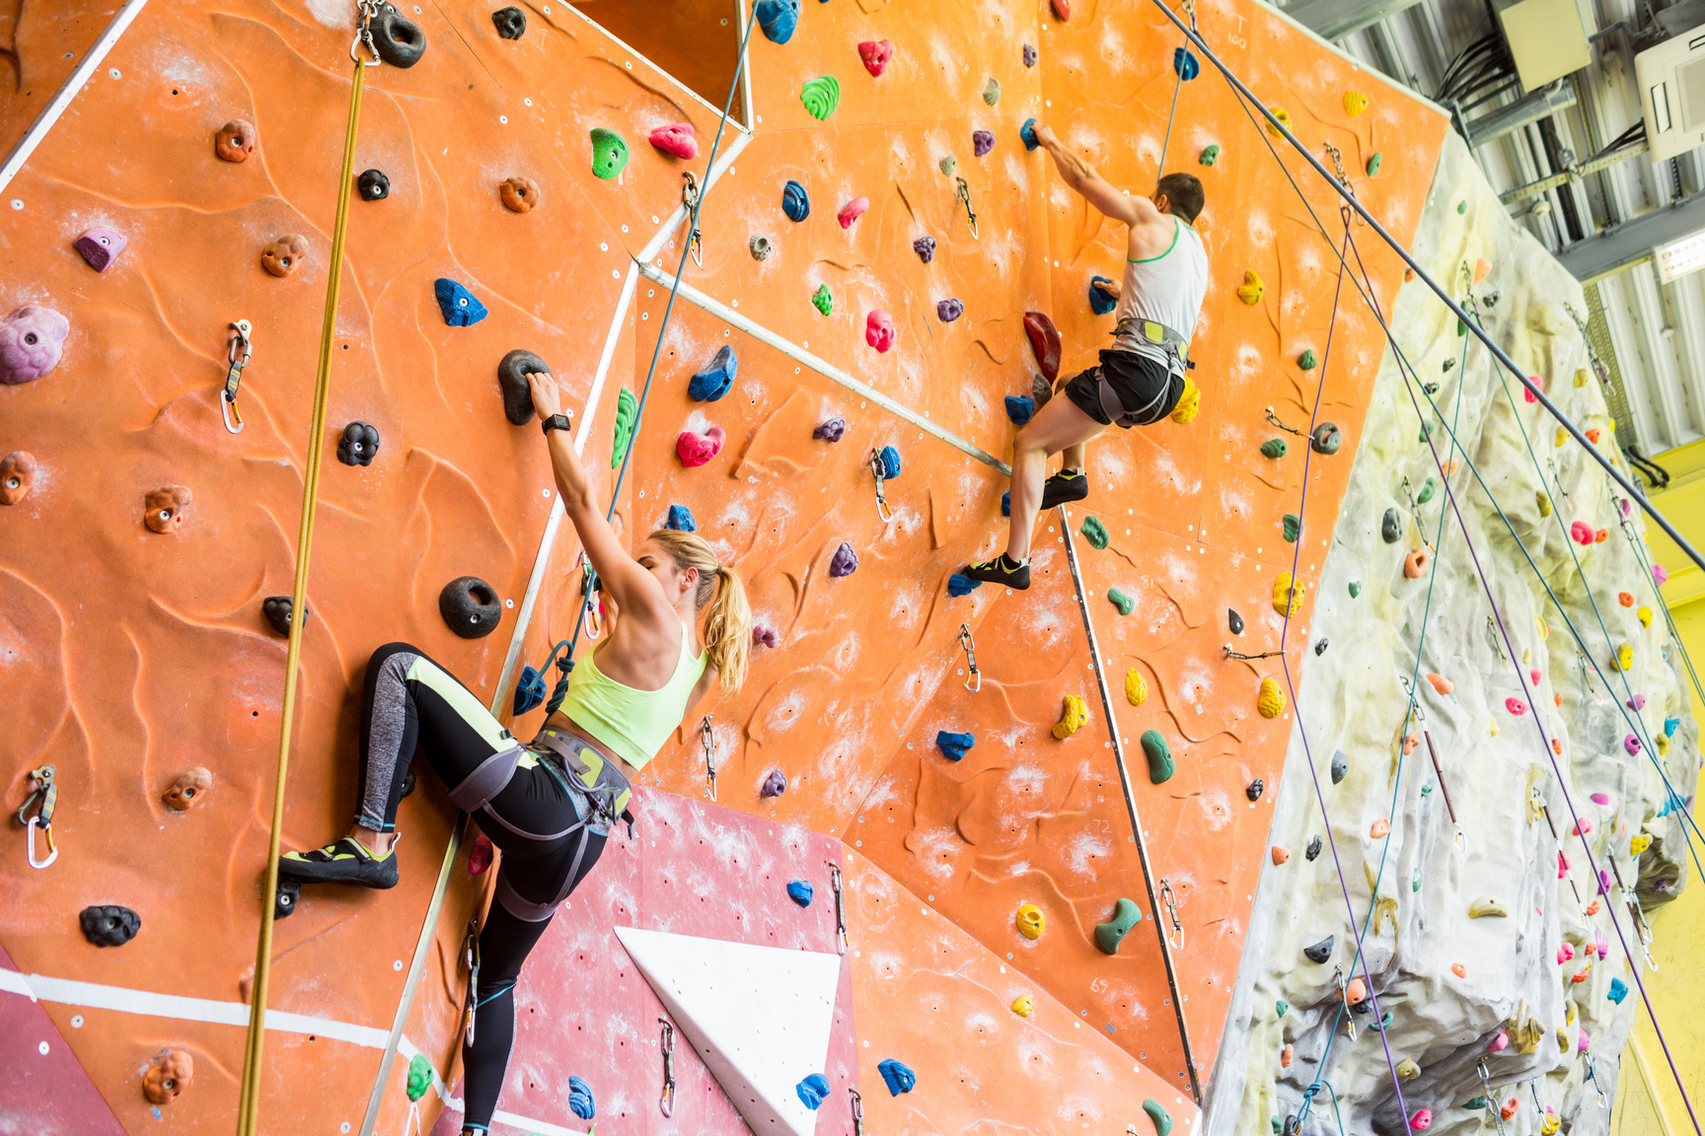
LOOK AT THESE ACTIVITIES, HAVE YOU DONE ANY OF IT.

Slide 5
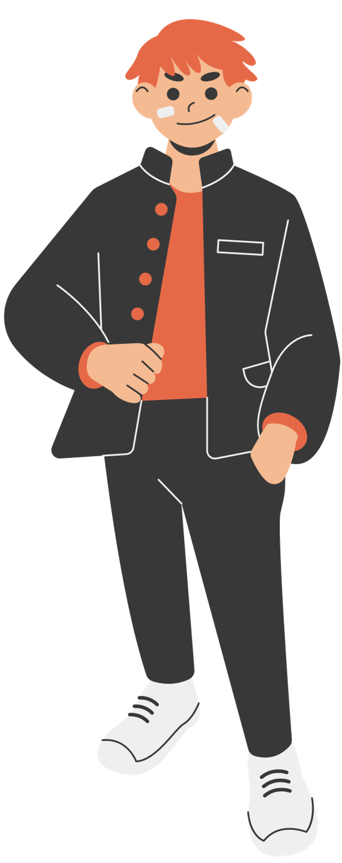




The present perfect tense is used to talk about experiences or actions that happened at an indefinite time in the past but still have relevance to the present.
Examples of present perfect statements:
I've seen a lion in the wild.
She's climbed a mountain.
We've visited ancient ruins.

Slide 6

QUESTION & ANSWERS
Have you ever gone snorkelling in the coral reef?
Have your friends ever gone skydiving?
Has your family ever hiked to the top of a volcano?
Yes, I have gone snorkeling in the coral reef. It was an amazing experience.
No, my friends haven't gone skydiving, but they are interested in trying it someday.
No, my family hasn't hiked to the top of a volcano, but we hope to do it in the future.

Slide 7



LET'S BE PRODUCTIVE!
This session requires all students to share one of their memories of having an adventurous time. Students are encouraged to ask each other questions

Slide 8


THANK YOU
SEE YOU IN THE NEXT CLASS!

